Slide 1
Molecular Phylogeny & Evolution BIFX-550
S. Ravichandran, Ph.D. Biology,
Hood College, Frederick, MD 21701

Slide 2
Goals
Molecular clock hypothesis and significance
Positive/negative selection and test its presence in sequences of interest
Types of phylogenetic trees and basic concepts
branches, nodes, roots
Creating and evaluating phylogenetic trees
Distance-based and character-based method

Slide 3
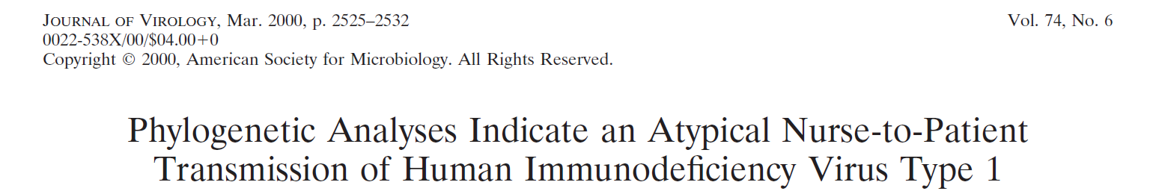
Seropositive: Test of Blood Serum
A human immunodeficiency virus (HIV)-negative patient with no risk factor experienced HIV type 1 (HIV-1) primary infection 4 weeks after being hospitalized for surgery. Among the medical staff, only two night shift nurses were identified as HIV-1 seropositive. No exposure to blood was evidenced. To test the hypothesis of a possible nurse-to-patient transmission, phylogenetic analyses were conducted using two HIV-1 genomic regions (pol reverse transcriptase [RT] and env C2C4), each compared with reference strains and large local control sets (57 RT and 41 C2C4 local controls). Extensive analyses using multiple methodologies allowed us to test the robustness of phylogeny inference and to assess transmission hypotheses. Results allow us to unambiguously exclude one HIV-positive nurse and strongly suggest the other HIV-positive nurse as the source of infection of the patient.

Slide 4
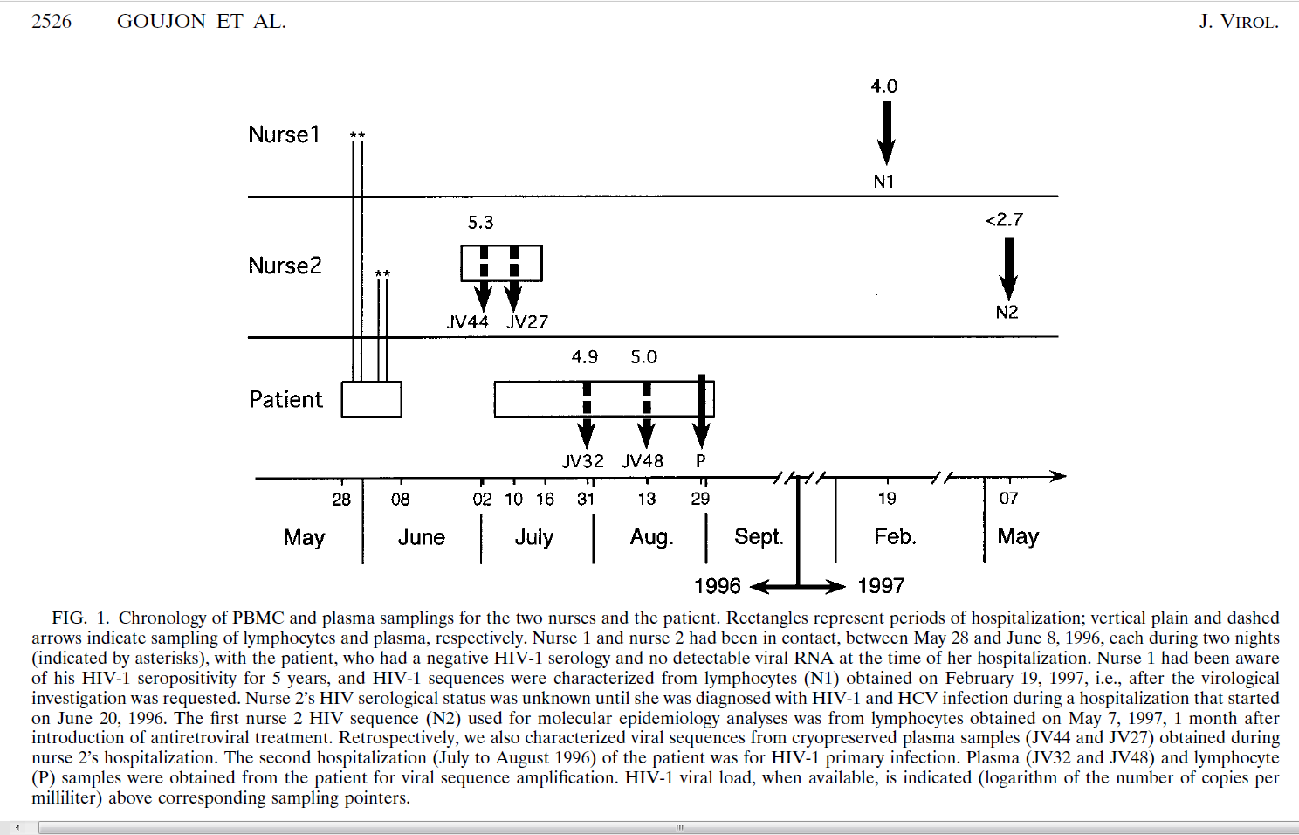
Plasma samples (JV44 and JV27) and (JV32 and JV48)
Contact with patient
Log(# copies/mL)
HIV-1 seropositivity
Viral loads tests tells you how much virus is in a mL of blood (or another body fluid being measured).
~ 599 copies of virus
Log(599)
P: Lymphocyte sample

Slide 5
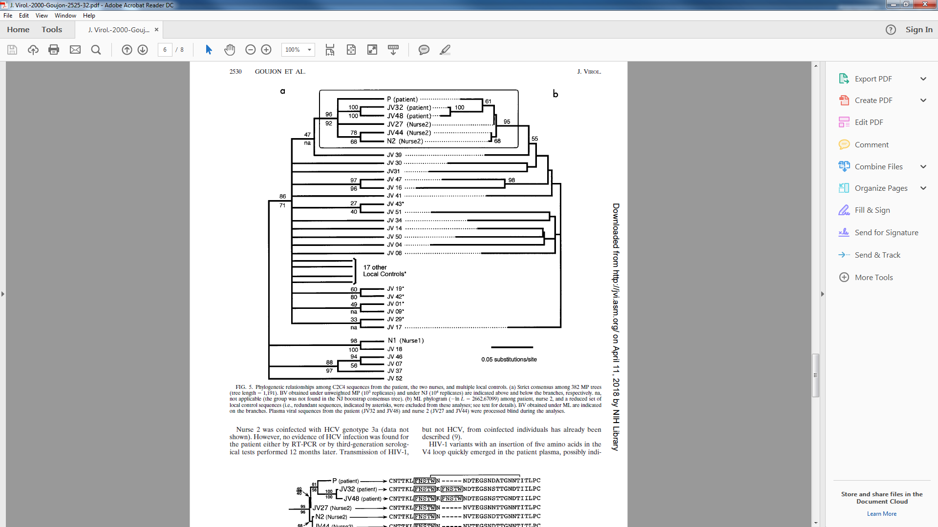
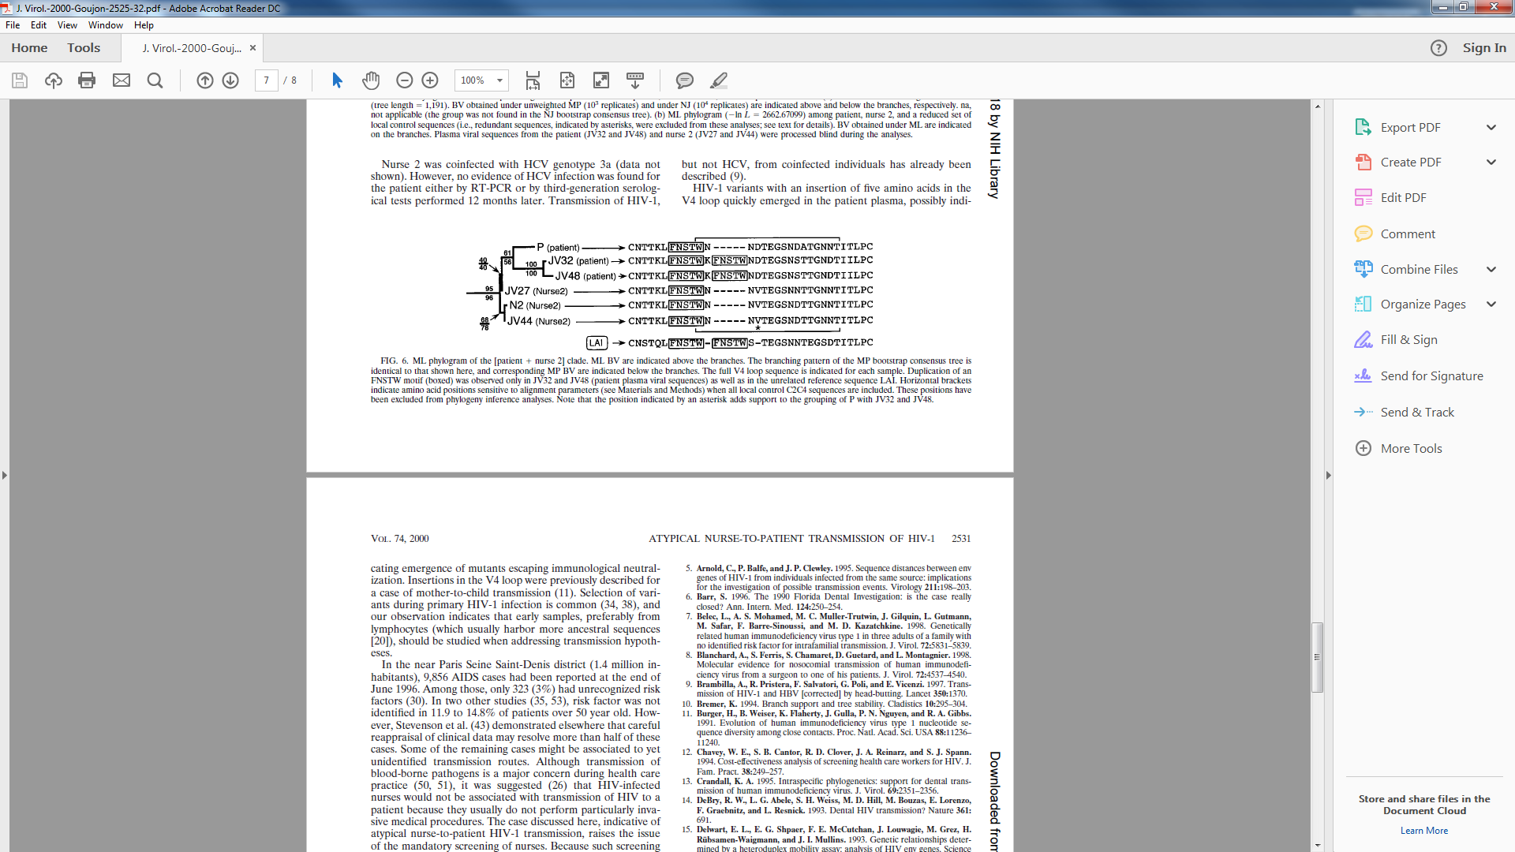

Slide 6
Another example using Russian Flu Pandemic
Think about naming Pandemic by country names is a good idea.
We talked about this during the first class. Check the C-1 slides

Slide 7
Evolution
Process of change
Children resemble their parents
Over generations there will be changes and start to look different
Changes occur over the time. Mechanisms of change
Environmental factors
Mutation
Sexual reproduction

Slide 8
Evolution
Common Ancestor
5 MYA
Apes (Gorillas and Chimps)
Hominids
Misconceptions
Chimp → Man (Wrong)
Humans are more closely related to apes than monkeys
Did we evolve from apes? No
Concept of God
What is phylogeny?
Inference of evolutionary relationships
How can we do this?
Comparing morphological relationships
We can also use molecular fingerprints
Humans

Slide 9
Phylogeny
Inferred evolutionary relationships (hypothesis) between organisms (taxa) can then be drawn using a tree
Key concepts:
All life forms share a common origin called common ancestor
More than 99% of all species that lived were extinct
Among extant organisms, closely related ones were evolved from recent common ancestor than the distant relative organisms

Slide 10
Goals of Phylogeny
Build correct trees (evolutionary relationships) for all species of life
Just one tree that includes all species of life
Identify when the divergence happened (time of evolution)
In general, phylogeny is done by comparing phenotypic features
presence or absence of Wings or spinal cords etc.

Slide 11
Goals of Modern Phylogeny
Molecular Phylogeny
Evolution Is nothing but mutation with selection
We can call this substitutions
“Substitutions are fixed at a rate that depends on both mutation and selection” Pevsner
Comparison of genes/proteins throughout the different organisms (tree of life)
Use this information to build an inferred tree (for a hypothesis)
Also to estimate the time of divergence of two organisms
Who was their last common ancestor?

Slide 12
Phylogeny
Single tree; Is recreating it possible?
More over the lateral DNA transfer also adds complication
So, we can only infer and create models of trees
Using sequences and a hypothesis
In general, tree of live includes three main branches:
Bacteria/Archea and Eukaryotes (NOT VIRUSES)
Prokaryotes: Bacteria/Archea (single celled organisms)

Slide 13
Molecular Phylogeny
From now on, we are going to focus on genes/proteins (sequences) to identify homologous sequences
BLAST was used
Why are we doing this?
Function

Slide 14
How to construct a phylogenetic tree? General scheme & Terminology
Collect sequences (taxa)
Align them (MSA)
Estimate the # of differences
Quantify them using numbers
Use the difference (%) measure to construct a tree
1
7
5
4
11
8
Ancestor: one that is connected to all lower nodes Children: share same parent End-nodes or leaves: No children Parent: if it is one step higher in the hierarchy
Other terms: Edges and Nodes

Slide 15
Inferred Tree
We are going to use Globins to study relatedness among globins
from same organism
from different organisms
This can answer concepts such as homologous or orthologous etc

Slide 16
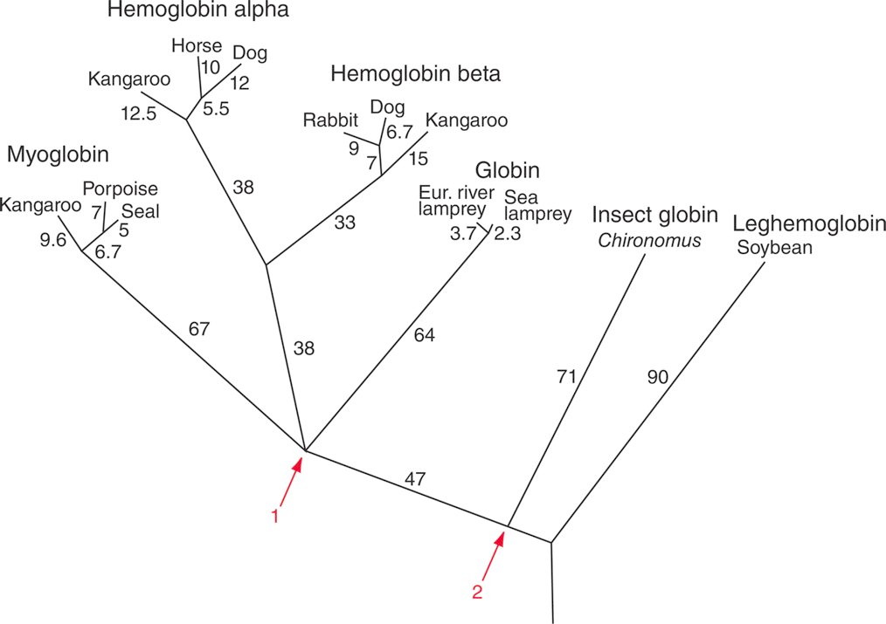
Inferred phylogeny using globins; Source Dayhoff Maximum Parsimony Approach
Source: Dayhoff et al. (1972). Reproduced with permission from National Biomedical Research Foundation. Fig 7.2 from Book
13 Globin gene from different species
Last common Ancestor of Vertebrate globins
Source: Dayhoff et al. (1972). (Pevsner 247)
Pevsner, Jonathan. Bioinformatics and Functional Genomics, 3rd Edition. Wiley-Blackwell, 2015-10-16. VitalBook file.
Last common Ancestor of Vertebrate & Insect Globins

Slide 17
Let us see how the globin genes evolved over time
Gene duplication and speciation
Time is estimated using fossil-based studies

Slide 18
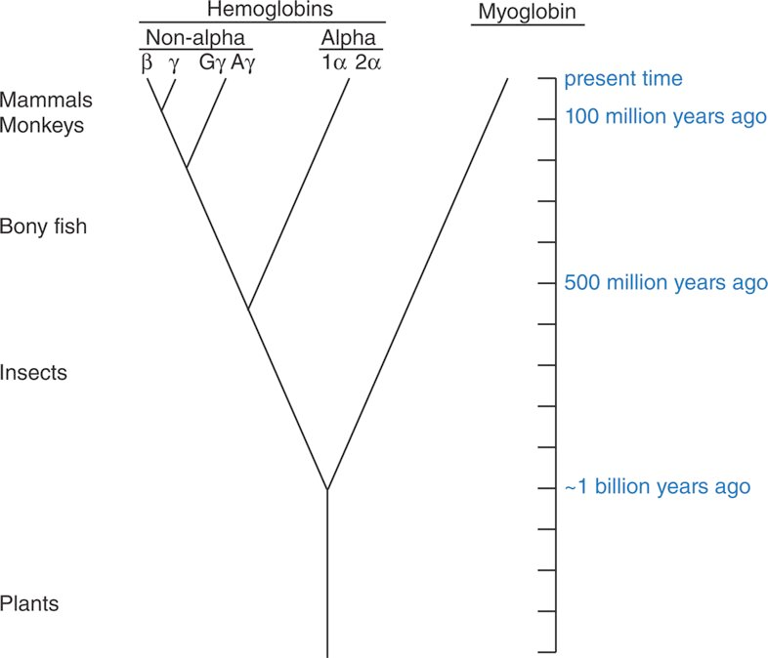
Source: Dayhoff et al. (1972). (Pevsner 248)
Pevsner, Jonathan. Bioinformatics and Functional Genomics, 3rd Edition. Wiley-Blackwell, 2015-10-16. VitalBook file.

Slide 19
Molecular Evolution using Insulin as an example
Two Things we will learn in this section
Sequence difference → Evolution
Sequence difference → Function

Slide 20
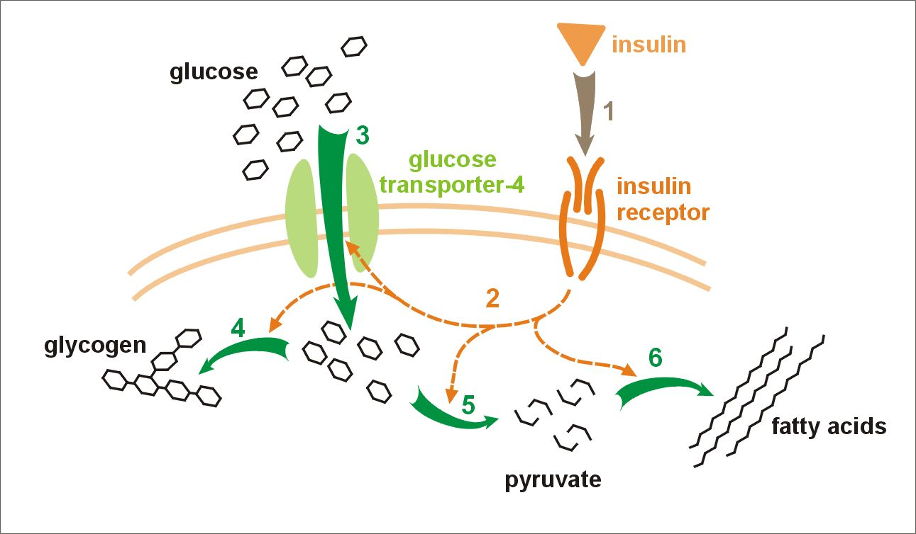
Insulin
Insulin is a small protein
It binds to INSR and controls the intake of glucose in muscle and liver cells
Hormone released by beta cells of Pancreas in response to raising levels of glucose in the blood
Blood
Signal Transduction

Slide 21
Insulin two types
Two types of insulin deficiency
Type 1
Insulin-producing beta cells are destroyed
No insulin can be made
Type 2
Not well understood
Insulin resistance

Slide 22
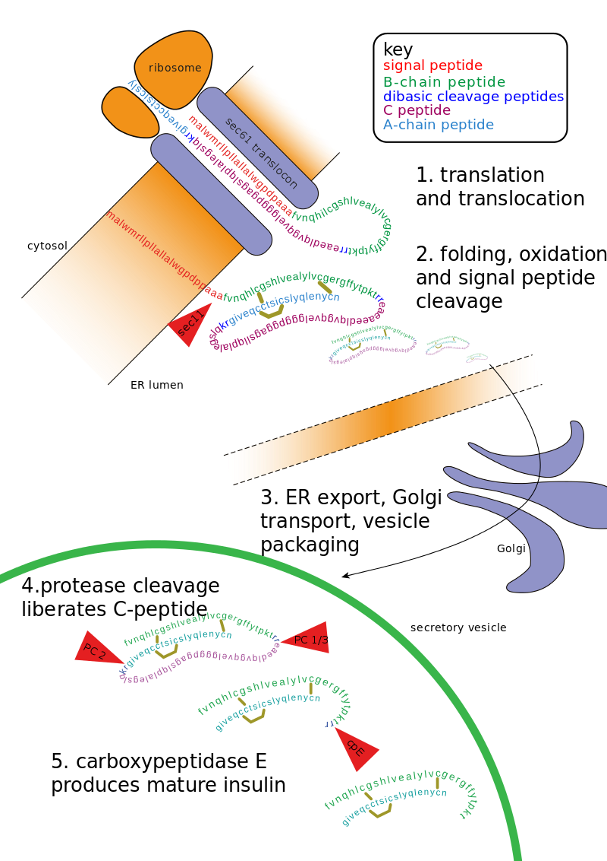
https://en.wikipedia.org/wiki/Insulin#/media/File:Insulin_path.svg
Insulin undergoes extensive
Post-translation modification

Slide 23
Evolution using Insulin as an example to understand evolution
Fred Sanger sequenced Insulin that eventually help us figure out the function of insulin

Slide 24
Insulin Biology Test System for Phylogeny
Sanger and others had sequenced insulin from Cow, sheep, Pig, Horse and Whale and found
The chains A and B are highly conserved
There are mutations (in some regions more and in some less)
Changes occur non-randomly
In some places the impact to function are dramatic and in some cases it is less influential

Slide 25
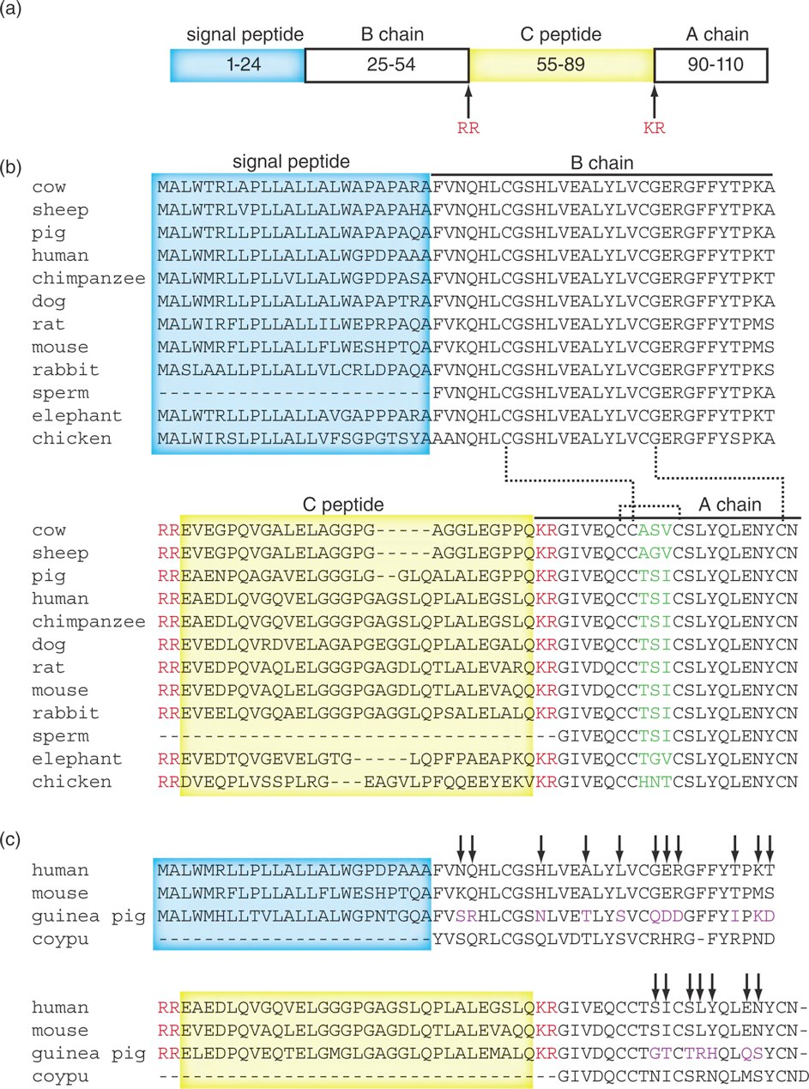
Signal peptide: Intracellular transport
Fig. 7.3 from Book
Sperm: Sperm Whale
C chain evolves faster (6 fold faster) than A and B chains

Slide 26
>sp|P01308|INS_HUMAN Insulin OS=Homo sapiens GN=INS PE=1 SV=1
MALWMRLLPLLALLALWGPDPAAAFVNQHLCGSHLVEALYLVCGERGFFYTPKTRREAED
LQVGQVELGGGPGAGSLQPLALEGSLQKRGIVEQCCTSICSLYQLENYCN
Dibasic residues (KR and RR) where the cleaving occurs
Signal chainB ChainC ChainA
Proteases cleave the protein into segments
S-S
Dimers

Slide 27
Summary based on MSA
Functionally active chains A and B are more conserved than non active C
C peptide evolves at the rate of 2.4x10⁻⁹ mutations per amino acid site per year
A and B sites are 0.4x10⁻⁹ mutations per amino acid per year
About 6 fold difference

Slide 28
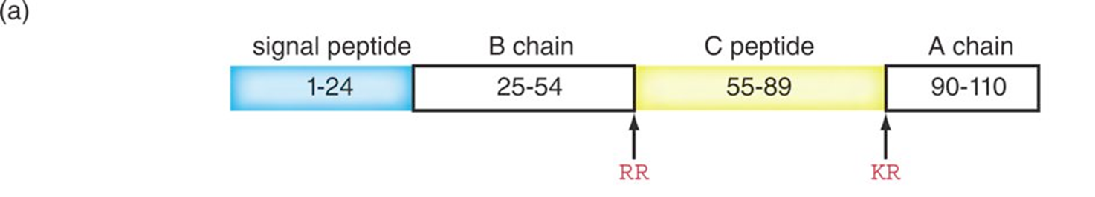
Evolution using Insulin as an example
Coypu: Myocastor coypus, P01330.1 Pig and Coypu insulin evolves much faster (~6 fold) than Human

Slide 29
Faster evolution of Pig and Coypu
do not bind to Zn ions but Human and Mouse do
So less constraint
Insulin from Coypu is less potent and mostly monomeric

Slide 30
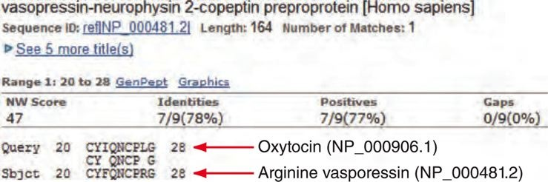
Example: Even a couple of AA changes can modify the function
Fig 7.4 from Pevsner III Edition
Only 2 changes between Vasopressin and Oxytocin but they both have vastly different function.

Slide 31
Structure and Function
The structures of Hemoglobin and myoglobin (similar sequence and structures; oxygen carriers) indicated that there is a relationship between sequence similarity and fold
Oxytocin example also showed that small differences can in some cases cause difference in function

Slide 32
Molecular Evolution and Clocks
Molecular Clock Hypothesis

Slide 33
Some proteins evolve slowly (Cytochrome c) and some proteins evolve faster (fibrinopeptide)
One hypothesis states that for every given gene (or protein), the rate of molecular evolution is approximately constant. (Molecular Clock Hypothesis)
Zuckerkandl and Pauling, Emanuel Margoliash(1962)
Human globins
Beta and Delta (6 aa differences)
Beta and Gamma (36 aa diff.)
Human vs Gorilla both α and β globins (2 or 1 diff. respectively)
 | a | b | g | d | e
a
b | ~78
g | ~83 | ~36
d |  | ~6
e

Slide 34
human globins
β and δ (~ 6 differences)
β and γ (~ 36 differences)
β and α (~ 78 differences)
α and γ (~ 83 differences).
Human and Gorilla
α/β 2/1 differences
Fossil evidence
Human and Gorillas common ancestor ~ 11MYA million years ago
Based on this they estimated common ancestor to all the different globins

Slide 35
human globins (common ancestor)
β and δ (~ 6 differences) - 44 MYA
β and γ (~ 36 differences) - 260 MYA
β and α (~ 78 differences) - 565 MYA
α and γ (~ 83 differences) - 600 MYA
Human and Gorilla
α/ α 2/1 differences
Fossil evidence
Human and Gorillas common ancestor ~ 11MYA million years ago
Based on this scientists estimated common ancestor to all the different globins

Slide 36
Since the number of effective mutational events are higher since the divergence had occurred. We need a correction formula
Evolution = mutation with selection = Substitutions
Constant rate assumption by Pauling, Emanuel Margoliash and Zuckerkandl have to be modified

Slide 37
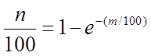
m = 60%
n = ~ 45%
Richard Dickerson (1971)
m
the total number of amino acid changes which have occurred in a 100-amino acid segment of a protein
n
The observed number of amino acid changes per 100 residues.
PAM Matrices section: Dayhoff et all theory states that two proteins of length 100 that share 50% amino acid identity have sustained an average of 80 change

Slide 38
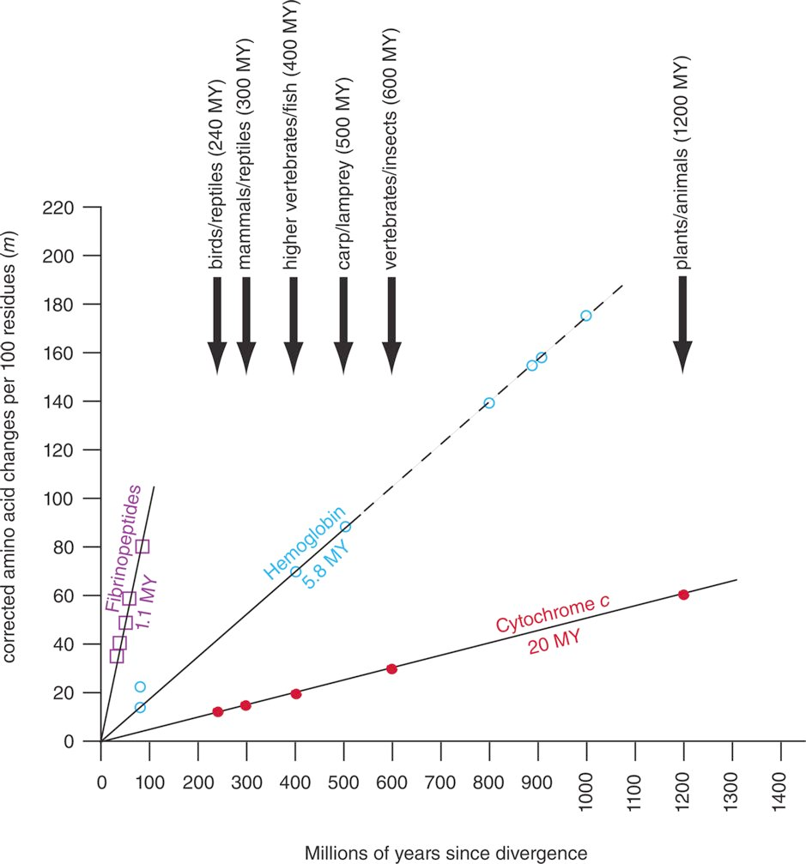
Amino acid substitution rate
Arrows indicate speciation identified using fossil evidence
You can compare two proteins and estimate the divergence. But, this is not accurate because of multiple substitutions may occur in a site. So, to accurately predict, Dickerson used a correction formula for estimation

Slide 39
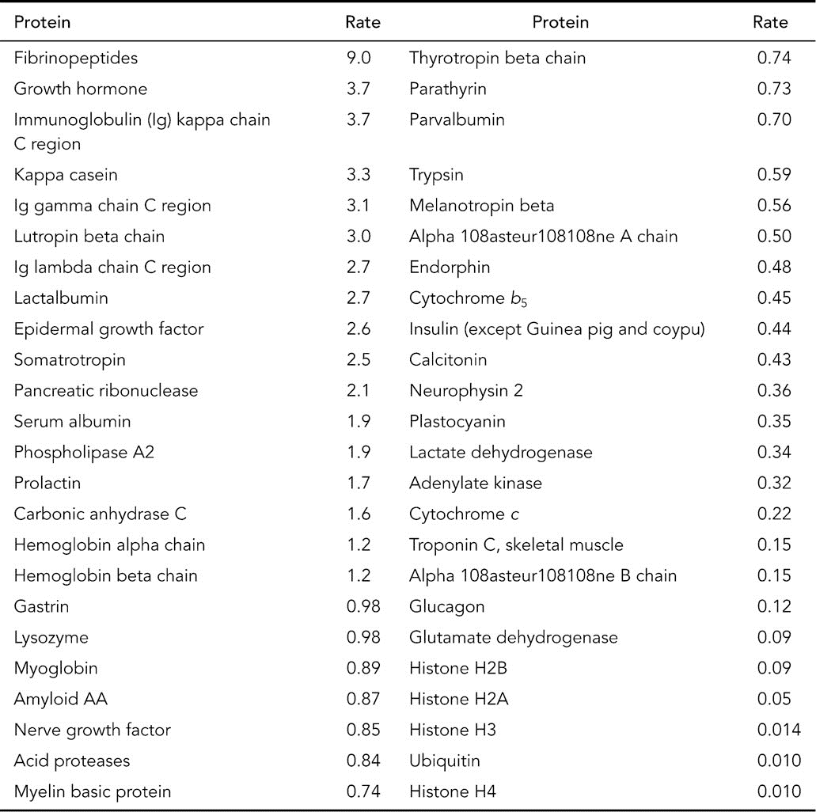
Rates of amino acid substitutions per amino acid site per 109 years (λ × 109) in various proteins
Table 7.1 from Book

Slide 40
Before we proceed
We have to understand what is a substitution and what is mutation
Mutation
biochemical process that reflects the change
Polymerase copies DNA at a particular mutation rate
Substitution
is the observed change that we see in the sequences
Ex comparing different histone sequences

Slide 41

Histones undergo substitution slowly but not mutating slowly
Substitution is mutation with selection
Rate of aa sub per year per 10⁹ years ( λ x 10⁹)

Slide 42
How substitutions get fixed
Observed substitutions that are fixed in the population depends on both mutation and selection
Key take-home message is if the sequences evolve at a constant rate, this information can be used to estimate the time (ex divergence)
Like the radioactive decay etc.

Slide 43
Molecular Clock
Molecular clock is still useful
Here are some cases where it fails
Doesn’t apply to all proteins
Viruses have rapid evolution and different from proteins
As long as the gene is functional the constant rate is applicable
When gene → non-functional or duplication the rate changes

Slide 44
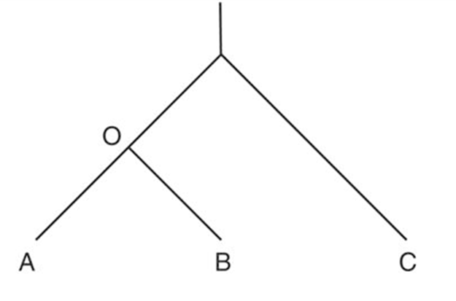
How to check the evolution rates?
Tajima (1993) introduced a test for whether DNA or protein sequences in two lineages (such as human and chimpanzee) undergo evolution at equal rates.
H₀: Rate1 = Rate2
H_{A}: Not so
Chisq test at p = 0.05 significance

Slide 45
Chisq test
n_iii Identical in all 3 sequences
n_ijk Divergent in all 3 sequences and Unique differences in Seq A (n_ijj) and others such as n_jij and n_jji etc.
Chisq Goodness of fit
Compares
What is observed (# of substitutions)?
WITH
What is expected?
Comes from OutGroup
Rate = r = (K/2T) Rate of nucleotide substitutions/per site per year
2T is the time of divergence in 2 separate lineages
Note T can also be estimated from Fossil evidence
K: # of substitutions/site
GeneA GeneB GeneC
Rate x y
Percentage

Slide 46
Species A
AAGCTCAAC
TAGCTCAAC
AAGCTCAAG
A and B differ by 4 bases
Ancestor
ACGCTCAAG
ACGCGCAAG
Species B
Let us say, if we know that the Rate is 1 mutation/5 Million years (fossil records)
Note the rate is constant
Time
Time of divergence = 2 mutations each x 5 million years = 10 million years
Based on Mr. Rahilly’s notes on Molecular clocks

Slide 47
Molecular Clock
Species A
Mutation rate is constant and estimated using fossils = 1 mutation per 2 million years
Species B
Species C
18 differences between species B and C
9 mutations
9 mutations
Time of divergence = 9 x 2 mutation per 2 Million years

Slide 48

What does Tajima test identifies?
Test in Mega, refer to full Presentation
“Tajima's test determines whether there is accelerated evolution in lineage A or B, in which case we reject the null hypothesis that A and B exhibit equal evolutionary rates.”
Calculate # of substitutions
ABC, BAC (ABC: # of sites in B and C that are difference from A)
We can infer the distances
OA, OB, OC
MEGA can be used to make the prediction
Computer LAB
BOX 7.1 provides Math Background

Slide 49
Positive Selection
Test in Mega, refer to full Presentation
Phenotypic level
Darwin's theory of evolution
“traits in a population that enhance survival are selected for (positive selection), while traits that reduce fitness are selected against (negative selection).“
Long-necked Giraffes
Molecular Level
Lysozyme function modified when a duplication occurred
Antimicrobial and digestive functions

Slide 50
If we have 2 aligned sequences (homologous; hemoglobin A in human/mice)
?
Whether the differences between 2 sequences are due to natural selection or neutral
We answer this by looking at the substitutions in the sequence

Slide 51
How to measure +/- Selection
Rate (r) = K/2T
dN:
Rates of non-synonymous sub/non synonymous site (ns sub. per ns site)
dS:
Rates of synonymous sub/synonymous site
dS > dN Negative Selection (purifying selection)
Removing alleles that are deleterious
When change is not tolerated
dS < dN Positive Selection (gain of function)
Duplicated gene exploring new function
SNAP and MEGA can perform such a calculation
Test in Mega, refer to full Presentation

Slide 52
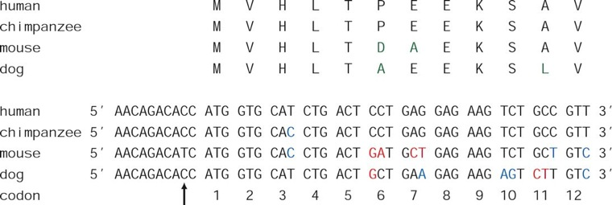
HBB Sequences (part of the sequences are shown)
Noncoding no pressure
(there are cases where the non-coding regions preceding a gene is strictly conserved)
Third codon change doesn’t make changes in the AA.

Slide 53
Use BlackBoard to extract HBB-hum-chimp-mouse-dog.fasta
Test in Mega, refer to full Presentation
Align using either EBI online page (www.ebi.ac.uk/tools/msa) or MEGA

Slide 54
The issue is, in human genome, there are substitutions happening all the time.
There also exists a theory of neutral substation. There are substitutions that neither under +/- Substitution, but neutral.
Ex Structural variations
“A typical human genome has ~3.5 million SNPs, most of which are intergenic (residing outside genes). Of the SNPs in exons, about 11,000 are synonymous and ~11,000 are nonsynonymous.” Pevsner

Slide 55
Molecular Phylogeny: Properties of Trees
We focus on Phylogenetic trees created from protein/DNA sequences
Topology of a tree
Common ancestor of 2 homologous protein sequences
Branch length indicate the degree of relatedness

Slide 56
In the next page, we will discuss the phylogenetic trees created by MEGA
The sequences are 9 globin DNA coding sequences (aligned using MUSCLE)
Four different way of building trees are shown
FIRST let us see how to upload sequences into MEGA

Slide 57
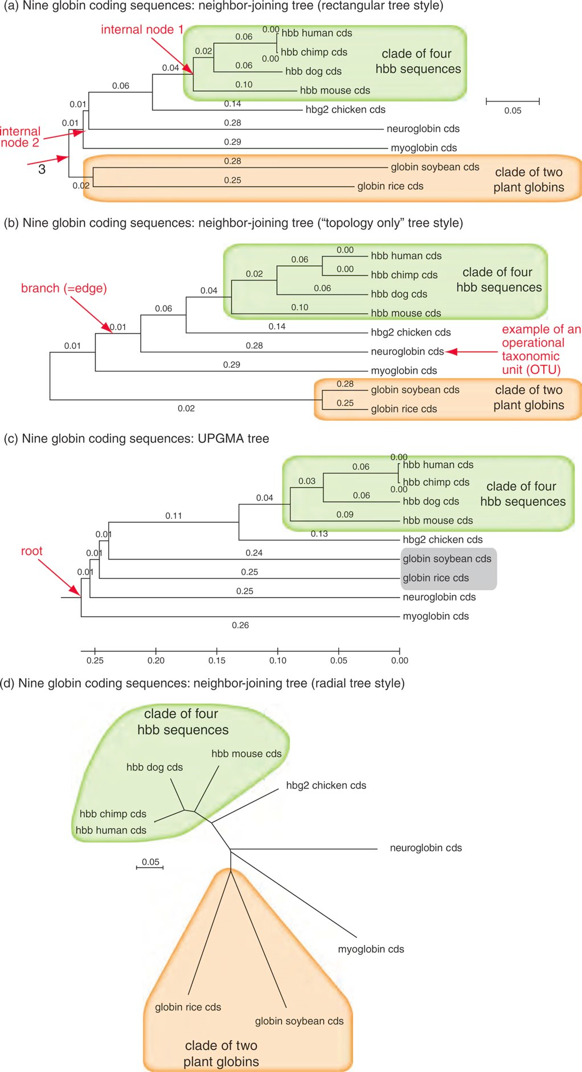
Evolution via Trees
Phylograms SCALED a,c,d NOT b
Each leaf is called Operational Taxon Unit (OTU) ; Extant (non-extinct)
Base differences/site Scaled UNROOTED
Root?
NOT Base differences/site UNSCALED; Cladogram

Slide 58
Evolution via Trees
Base differences/site Scaled
Rooted Tree
Base differences/site Scaled
UNROOTED (no ancestor)

Slide 59
Branch Length and Root
There is a discussion in the book about Length of the branches and the Root
Pretty straightforward and I will refer you to look in the book
Here are some highlights
Some OTUs can be swapped without affecting the topology of the tree (soybean and Rice)
Clade: Closely related sequences derived from a common ancestor + the ancestor (look at human clade; Note Chicken is not part of this group)

Slide 60
Tree Making and True Tree
Molecular alignments → Tree
More than one tree possible but there is only one true tree (because of our inability to model we build many trees and decide which one makes sense)
Topology of the tree that explains the evolutionary process of evolution
Several millions of trees are possible even for a dozen sequences
The number of bifurcating unrooted trees (N_{U} and NR) for n OTUs are given by Cavalli-Storza and Edwards

Slide 61
Tree Making and True Tree
Several millions of trees are possible even for a dozen sequences
The number of bifurcating (binary) unrooted trees (N_{U} and N_{R}) for n OTUs are given by Cavalli-Storza and Edwards
OTU = n

Slide 62
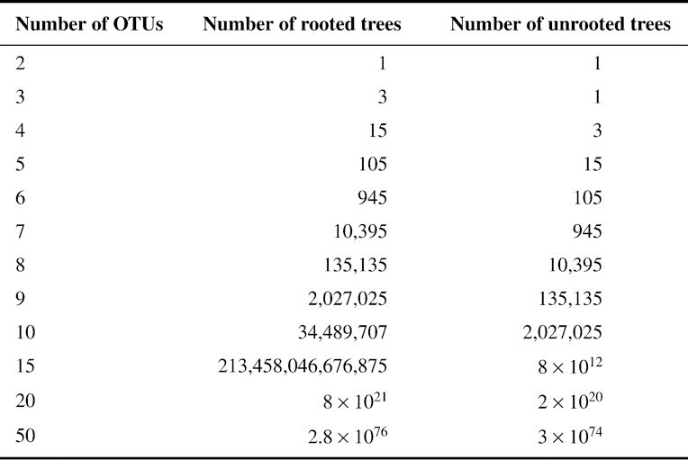
Box 7.3 from the book

Slide 63
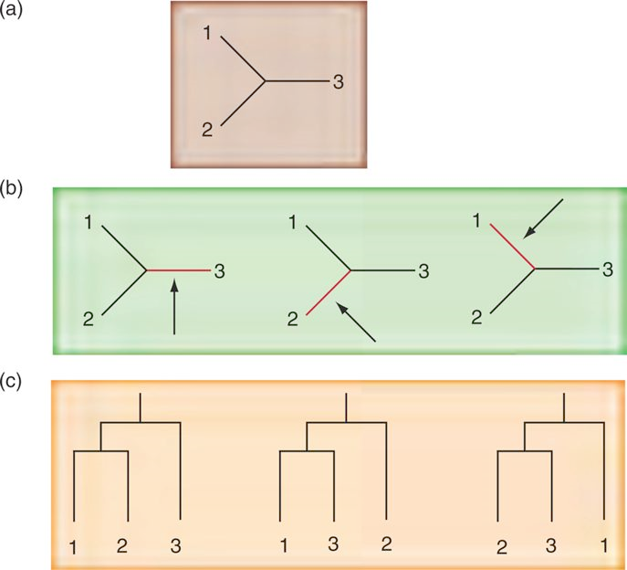
These can be Three aligned protein sequences
Figure 7.10 from Book
Any of the edges can be selected as a root
Rooted Tree from (b)

Slide 64
Exhaustive Searches
Examines all possible trees and selects the one with the most optimal features such as the shortest overall sum of the branch lengths.
limit is reached at around 12 sequences
6.5 × 108 possible unrooted trees
1.3×1010 rooted trees.
How do we build trees?

Slide 65
Heuristic
15 taxon you have 10¹⁵ UR trees. How do you evaluate all of them in a reasonable time?
“A heuristic algorithm explores a subset of all possible trees, discarding vast numbers of trees that have a topology that is unlikely to be useful.” Pevsner

Slide 66
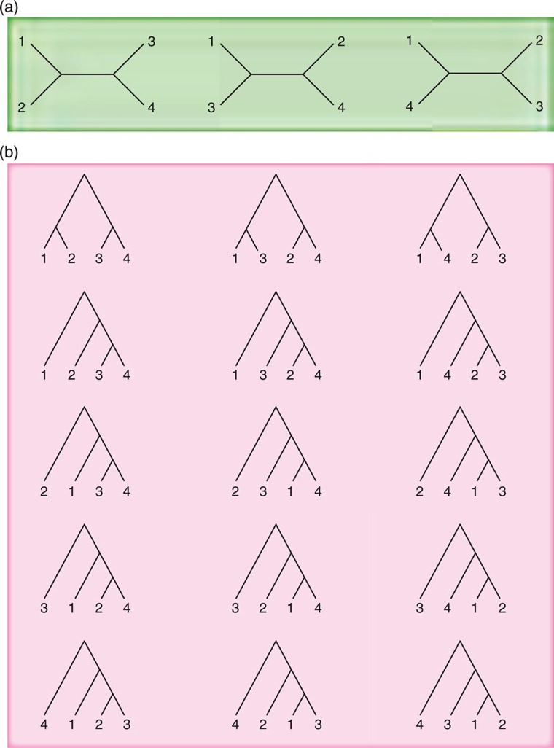
For 4 Operation Taxonomic Units (OUT) There are 3 possible UR trees and 15 possible Rooted Trees. Which one is the true one?
“One of these is a true tree in which the topology accurately describes the evolutionary process by which these sequences evolved”

Slide 67
# of different trees (hypothesis?

Slide 68
Several heuristic approaches to obtain optimal tree
Stepwise addition
Branch-and-bound
As each sequence is added.
We look for optimal tree in each group

Slide 69
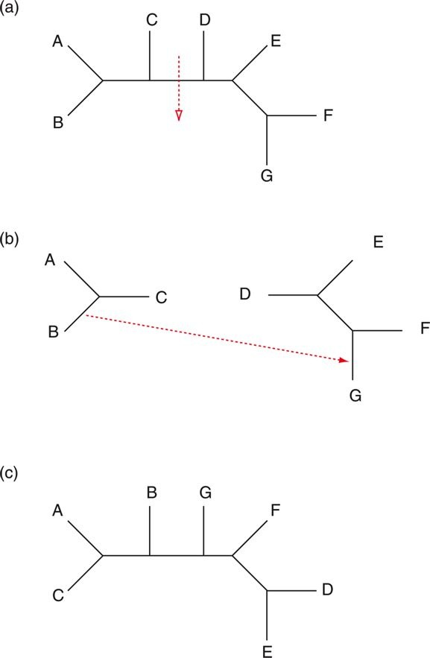
Branch Swapping using tree bisection reconnection approach (TBR)
Goal: Most optimal tree
Bisected along the branch to form 2 subtrees
These are reconnected by joining one branch from each sub-tree
All possible bisections will be evaluated?

Slide 70
Tree Types
Species, DNA, Protein

Slide 71
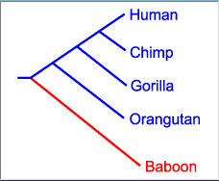

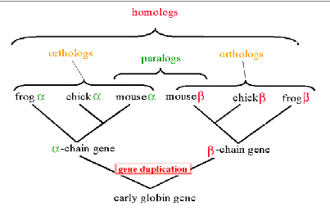
Tree Types
Species Trees
Internal nodes represent speciation
Species trees should be built only from orthologous genes
Gene Trees
NCBI Figure

Slide 72
DNA, RNA or Protein-Based Trees
In general you can use DNA/RNA/Protein sequences.
What sequence depend on what is the question
DNA
Allows nonsynonymous/synonymous substitutions

Slide 73
DNA, RNA or Protein-Based Trees
Noncoding region variations
Pseudogenes
Ones do not encode protein sequences
Inactive DNA transposons and other repetitive DNA elements
Rate of transitions and transversions

Slide 74
Five steps to create trees
Step 1: Sequence collection:
Homologene
Ensembl
BLAST outputs
Step 2: Create Multiple Sequence Alignment (MSA)
Use sequences from step I to create MSA
Make sure that you use homologous sequences

Slide 75
Five steps to create trees
Identifying non-homologues are not easy but if identified those sequences should be removed
Restrict the sequences only to protein coding DNA regions that are available for all taxa
Most Phylogenetic programs do not have a method to handle INDELs. So, the gap containing region should be deleted.
Most programs do this by default

Slide 76
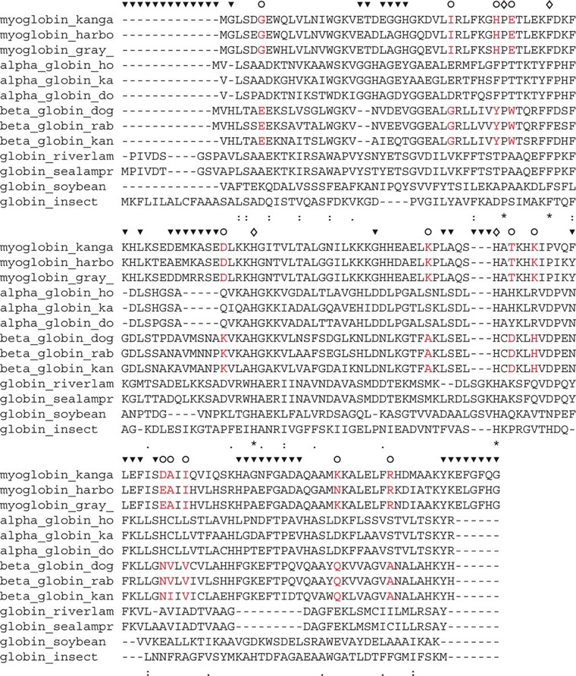
MSA: MAFFT-FFT-NS1
Areas should be removed
Fig. 7.17 Book

Slide 77
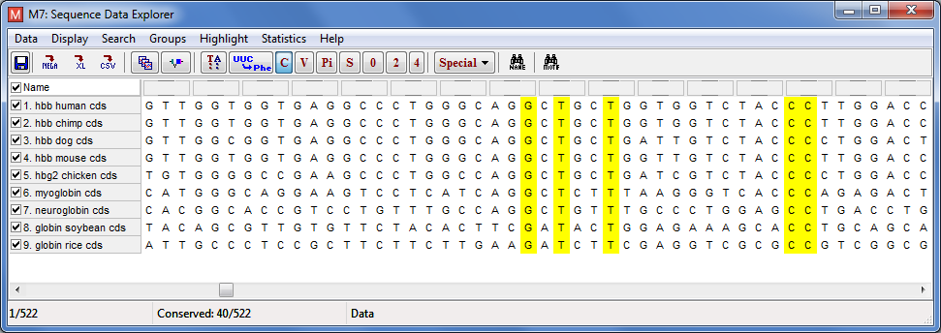
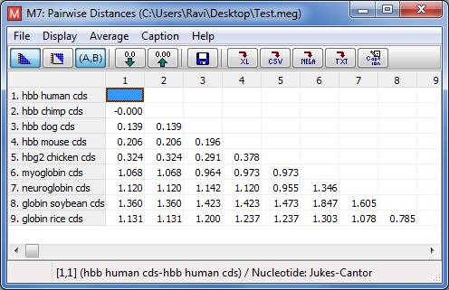
Five steps to create trees
Two types of trees
Character-based
Will use the characters (each column) to infer trees
Distance based
Will reduce the sequences into distance matrix and use that to build trees
Statistical methods
Maximum likelihood etc

Slide 78
Five steps to create trees
Step-3: Models of DNA/AA substitution:
For distance-based methods,
Distance between pair of sequences = # of mismatched positions
Scoring models (Ex. PAM, Jukes Cantor etc.) can also be used for calculating Distances
Character based methods
For maximum parsimony, the criterion for finding the best tree is based on the shortest branch lengths and, while individual characters are also evaluated

Slide 79
Five steps to create trees
Step-3: Models of DNA/AA substitution:
Maximum likelihood and Bayesian approaches
statistical models are applied to individual characters (residues) in order to assess the most likely topology as well as other features such as substitution rates along individual branches.

Slide 80
Let us explore distance-based methods

Slide 81
Estimating the Distance
Hemming Distance (degree of Divergence)
n is the number of sites that are different among N sites
Pros: Easy to compute
Cons: d is not the same as evolutionary distance. These distances do not take into account the multiple changes that has occurred in a site.
d in Mega is called “p distance”

Slide 82
Estimating the Distance
P = proportion of residues that differ Formula is based on Poisson distribution
Mega, this is called Poisson Correction
This is similar to the previous formula we looked earlier for evolution rate
Ideas for the model based on Poisson events
Rare events
Small prob. Of observing events across the genome (p proportional to λ Δt ; Delta Constant)
Changes are independent
Number of changes are constant over time

Slide 83
Impact of different Probability models
Sequences → Alignments (MSA) → compute distances (many types; Poisson models etc.) → Using clustering (N-J etc.), we build trees
Actual distances are different but get the same tree but the lengths are different

Slide 84
Distance from different models
Consider an alignment where 3 nucleotides out of 60 aligned residues differ. The normalized Hamming distance is 3/60 = 0.05.
The Jukes–Cantor correction d = – (3/4) ln[1 – (4 × 0.05/3)] = 0.052. In this case, applying the correction causes only a small effect.
When 30/60 nucleotides differ,
the Jukes–Cantor correction is – (3/4) ln [1–(4 × 0.5/3)] = 0.82,
a far more substantial adjustment.
Example from the book
Jukes-Cantor: Probabilistic model for mutations of nucleotides, assumes 4 bases are present in equal frequencies; equal chance of mutating to other; equal probability for transitions and transversion.

Slide 85
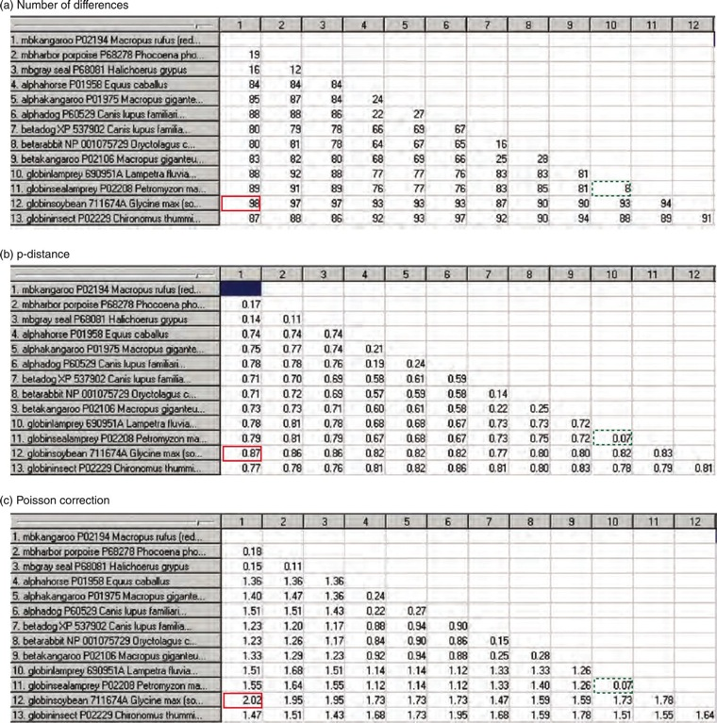
13 Globins
Red Distant sequences
Blue Close Seqs

Slide 86
bootstrap
For an rooted (5 taxa) there are 105 possible trees. Which one is correct?
Living or fossil is needed; if not then we can use bootstrapping; let us what is bootstrapping
Construct tree (original topology)
Drop taxa, reconstruct tree
Capture tree topology
Replace taxa and repeat for remaining taxa
Sum the topologies that retained orig. topology
Best tree is one that reproduces the original topology

Slide 87
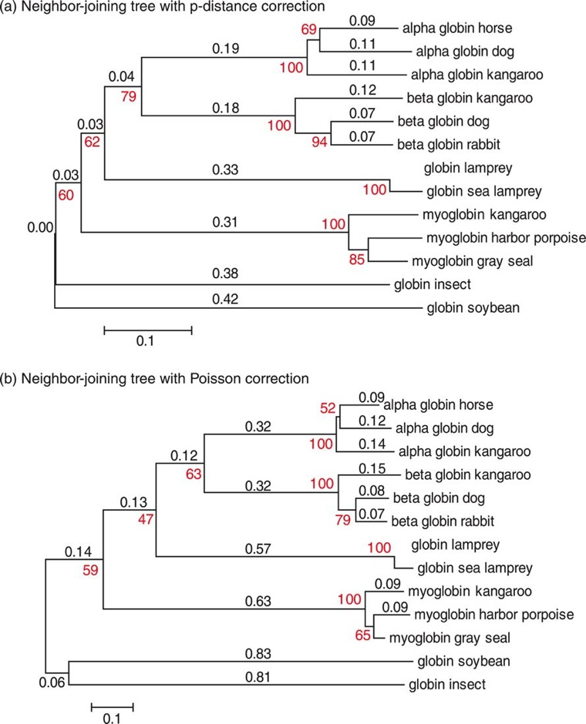
Red font indicates the confidence
When we create trees we indicate the number of bootstrap replicates that we want the model to use. And the numbers come from those trials
Example, in the clade that contain Horse, dog and kangaroo alpha globins, 100% of the bootstrap trials included them. So, high confidence
Look at the clade containing horse/dog alpha-globin only 52% trees joined those proteins; less confidence
P-distance
Same as HAMMING distance
Same Tree but with diff Distance
Poisson Correction

Slide 88
Five steps to create trees
While using the probability models, we assumed uniform rate of variation
This may or may not be correct, so a model that is based on gamma distribution can also be used
Gamma distribution also has a alpha parameter that can also be varied

Slide 89
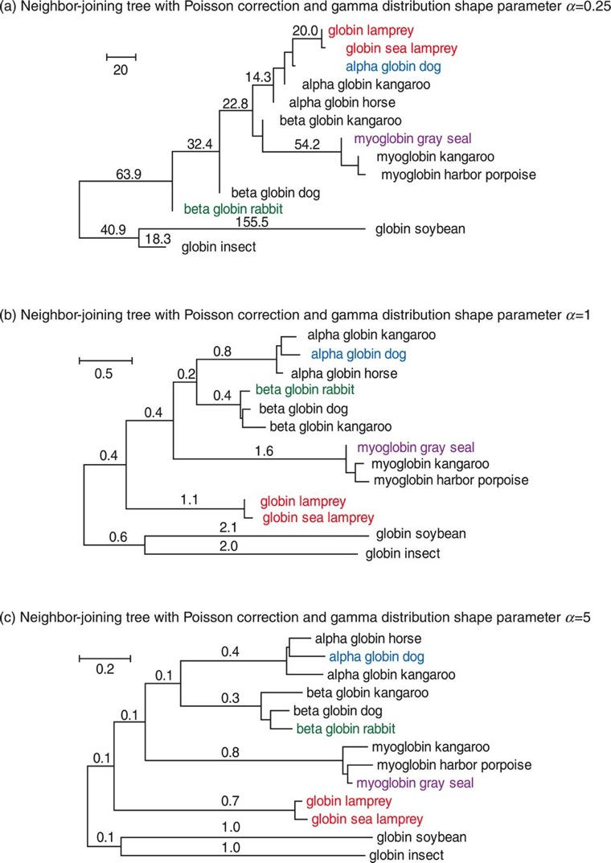
Five steps to create trees

Slide 90
Five steps to create trees
Length of the segment: Amount of Genetic Change
Protein sequences:
MEGA can do a variety of test and pick the best statistical model

Slide 91
Tree Construction Methods Summary
MSA → Distances (# of mismatched; or Scoring sub matrices (Jukes Cantor, Kimuara Nei)
 | Distance | Character (Discrete-based)
Clustering | UPGMA N-J
Optimal Search Criteria | Minimum Evolution | Maximum Parsimony Maximum Likelihood
They don’t use distances; Use mismatches directly to construct trees

Slide 92
Maximum Parsimony
 | A | T | G | C
A | 0 | 1 | 1 | 1
T | 1 | 0 | 1 | 1
G | 1 | 1 | 0 | 1
C | 1 | 1 | 1 | 0
Unweighted Scoring matrix; weighted is slightly different based on the base convertion
Tree X
MSA
Tree Y
Unweighted scoring scheme
1 mutation = 1 count
Sum of counts = Parsimony score
Goal is to achieve a lowest score (AKA Maximum Parsimony)
ACCC
ACCC
1
1
1
1
ACCA
ACCG
ACCA
ATCC
2
2
2
1
ATCG
ATCC
ATCG
ACCG
Score: 6
Less Parsimonious
Score: 5
More Parsimonious

Slide 93
We talked about distances, let us see how to use them to build trees

Slide 94
Five steps to create trees
Step 4: Tree-Building Methods
Distance-based; Maximum Parsimony; Maximum-likelihood and Bayesian inference
Let us start with Distance-based
Neighbor-joining (NJ), Unweighted-pair group method with arithmetic mean (UPGMA)
NJ is commonly used
For this class, we use UPGMA
Easy to explain

Slide 95
How does Distance-based work?
UPGMA
Start with distance matrix
What method to use?
Probability-based (Poisson corrected distances can be used) or Neighbor-joining
Basic distance metric properties
D(x,x) = 0;
D(x,y) = D(y,x);
D(x,y) <= D(x,z) + D(z,y)
https://en.wikipedia.org/wiki/Triangle_inequality

Slide 96
Distance Data Conditions
All distance data need to satisfy following 2 conditions in order to build the correct tree.
Condition # 1- Needs to be Ultrametric
All paths from each leave to the root are of equal length Branch lengths equal time
Mutation rate is not biased (i.e., Molecular Clock)
The 3-point condition holds for all possible combinations of 3 taxa
AB ≤ max(AC, BC)
AC ≤ max(AB, BC)
BC ≤ max(AC, BC)
Condition # 2 - Needs to be Additive – satisfies the 4-point condition
The 4-point condition holds for possible combinations of 4 taxa:
AB+CD ≤ max (AC+BD, AD+BC)
AC+BD ≤ max (AB+CD, AD+BC)
AD+BC ≤ max (AC+BD, AB+CD)
Based on UMD Class notes

Slide 97
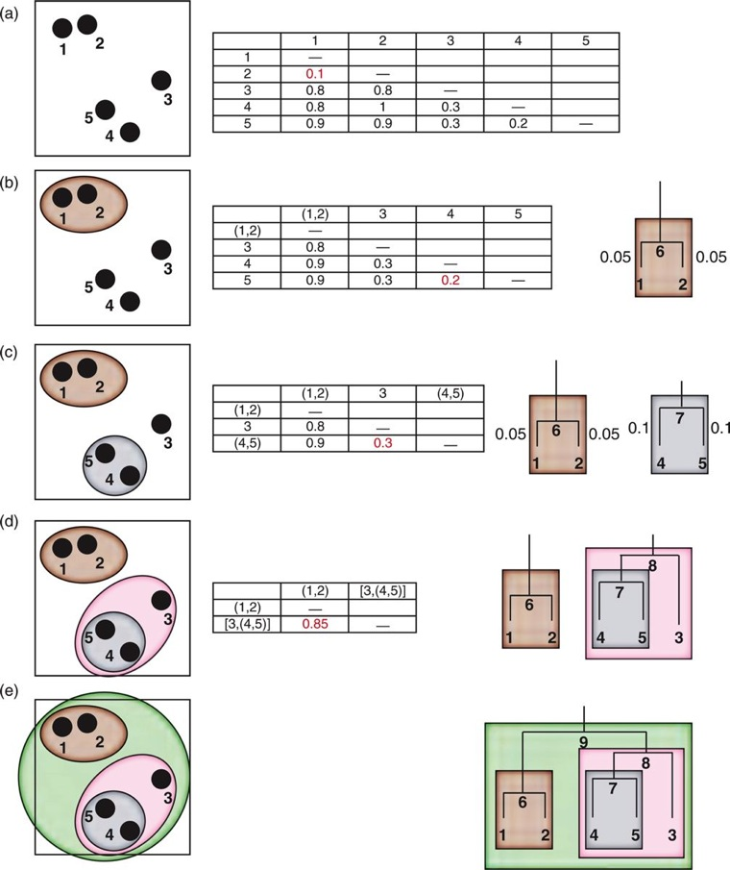
Distance-based UPGMA
Example distance matrix
Distance based → form clusters

Slide 98
Five steps to create trees
UPGMA Assumptions/limitations
Constant rate of substitution, based on the molecular clock applies to all lineages
If this is true, then branch lengths can be used to estimate dates of divergence
Produces rooted tree
Assumption of molecular clock (time)

Slide 99
Five steps to create trees
Distance based method, UPGMA is commonly used in Microarray analysis
NJ tree is more reliable than UPGMA
Clustering method like UPGMA
Doesn’t assume nor require distance data is ultrametric or additive

Slide 100
Five steps to create Trees
Maximum Parsimony
Best tree is with the shortest branch length possible

Slide 101
Five steps to create Trees
Which method do I use to build tree?
Following are some guidelines
Sequence-Similarity Method
Strong Parsimony (char. Based)
Weak Distance (NJ)
Very Weak Maximum likelihood

Slide 102
Five steps to create Trees
Tree Inference: Bayesian Methods
Assuming a model distance (Jukes Cantor etc.) → Trees
Probability based approach
Using uncertainty in complex models
Calculate the probability of observing some data given some probability model (ex. Tree == Model)
It seeks the probability of a tree given a model

Slide 103
Five steps to create Trees
p[Tree|Data] is called posterior probability (correct Tree)

Slide 104
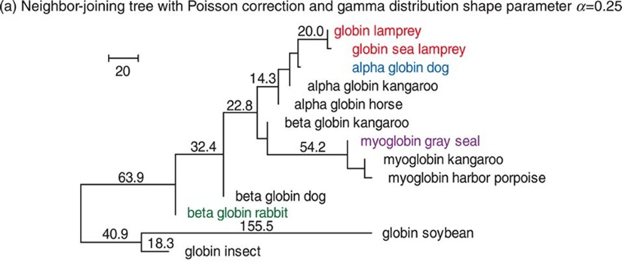
Five Steps to create trees
Step 5: Evaluating Trees
Boostrap analysis
Provides an estimate of robustness of tree topology
Mega: The percentage of times that a given clade (group of sequences) is supported in the original tree. These values are also given in the MEGA trees
“Bootstrapping describes the robustness of the tree topology: given a particular branching order, how consistently does a tree-building algorithm find that branching order using a randomly permuted version of the original dataset? Bootstrapping allows an inference of the variability in an unknown distribution from which the data were drawn”

Slide 105
A human immunodeficiency virus (HIV)-negative patient with no risk factor experienced HIV type 1 (HIV-1) primary infection 4 weeks after being hospitalized for surgery. Among the medical staff, only two night shift nurses were identified as HIV-1 seropositive. No exposure to blood was evidenced. To test the hypothesis of a possible nurse-to-patient transmission, phylogenetic analyses were conducted using two HIV-1 genomic regions (pol reverse transcriptase [RT] and env C2C4), each compared with reference strains and large local control sets (57 RT and 41 C2C4 local controls). Extensive analyses using multiple methodologies allowed us to test the robustness of phylogeny inference and to assess transmission hypotheses. Results allow us to unambiguously exclude one HIV-positive nurse and strongly suggest the other HIV-positive nurse as the source of infection of the patient.
Maximum Liklihood; Neighbor-Joining (NJ), Paup software

Slide 106
Self-test Quiz and Computer Lab/Problems
Complete all the self-test quiz questions
Pages 297-298
Complete Problems/Computer Lab questions 7-1 and 7-2.
Pages 297-298

Slide 107
Extra

Slide 108
Character-Based: Parsimony
1 A A G A G T G C A
2 A G C C G T G C G
3 A G A T A T C C A 4 A G A G A T C C G
MP identify phylogenetically informative sites:
Site 1 is informative? No Site 2 is informative? No
(all trees require 1 change)
Site 3 is informative? (all trees require 2 changes)
Site 4 informative? No. (all trees require 3 changes) Site 5 informative? Yes
Site 5 (left tree) is most parsimony tree
(Tree that minimizes the # of changes)

